Slide 1











PROJECT ASSESSMENT REPORT
Course: Deep Learning and Reinforcement Learning
Project Title: California House Price Prediction
Team Members:
Niharika R B 1BG23CS093
Neha B 1BG23CS092
M Hithesh Kumar 1BG23CS071

Slide 2
Project Objectives
To build a deep learning regression model that predicts housing prices using California housing dataset.
Use new feature to improve prediction accuracy and reduce error.

Slide 3
Methodology and Workflow
Data Loading: Load California housing dataset using fetch_california_housing() from Scikit-learn.
Feature Engineering: Create new features (like rooms per person, population per household, etc.) to enhance the model’s ability.
Preprocessing:
Combine original and new features.
Split data into training and test sets.
Normalize features using StandardScaler.

Slide 4
Model Design:
Build a deep neural network using Keras Sequential API.
Use layers with ReLU activation, BatchNormalization, and Dropout.
Training:
Compile the model using Adam optimizer and MSE loss.
Use EarlyStopping to avoid overfitting.
Evaluation: Test on unseen data using MAE and MSE metrics.
Visualization: Plot training vs validation loss and MAE.

Slide 5
Key Assumptions
Data quality is assumed to be clean with no missing values.
All added features are assumed to contribute meaningful patterns.
MAE is used as the main performance metric due to interpretability.
House price (Target) is treated as a continuous variable suitable for regression.

Slide 6
Model Evaluation and Analysis
MSE (Mean Squared Error): Measures average squared difference between predicted and actual values
MAE (Mean Absolute Error): Measures average absolute difference
Result :
Final MAE: 0.36
Model shows reduced overfitting due to Dropout and EarlyStopping
Feature engineering improved performance

Slide 7
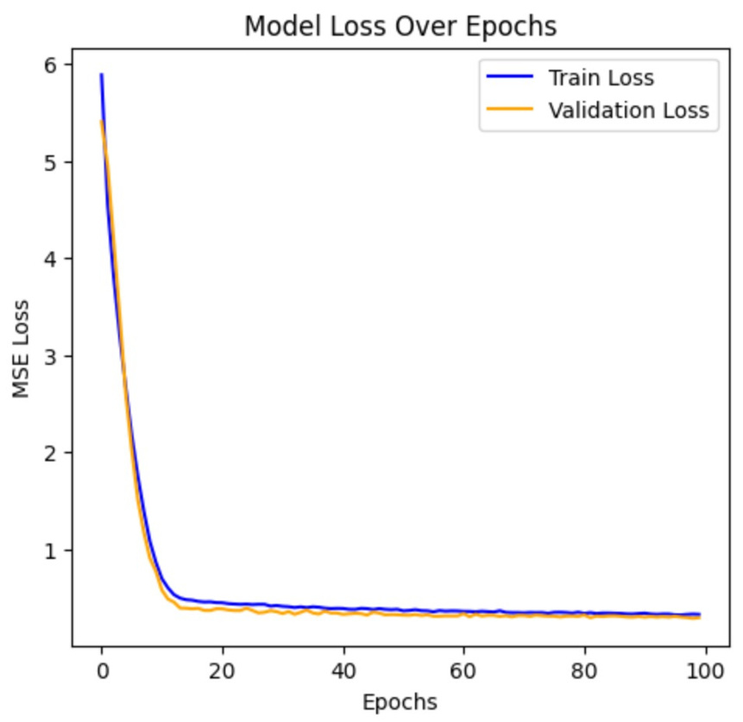
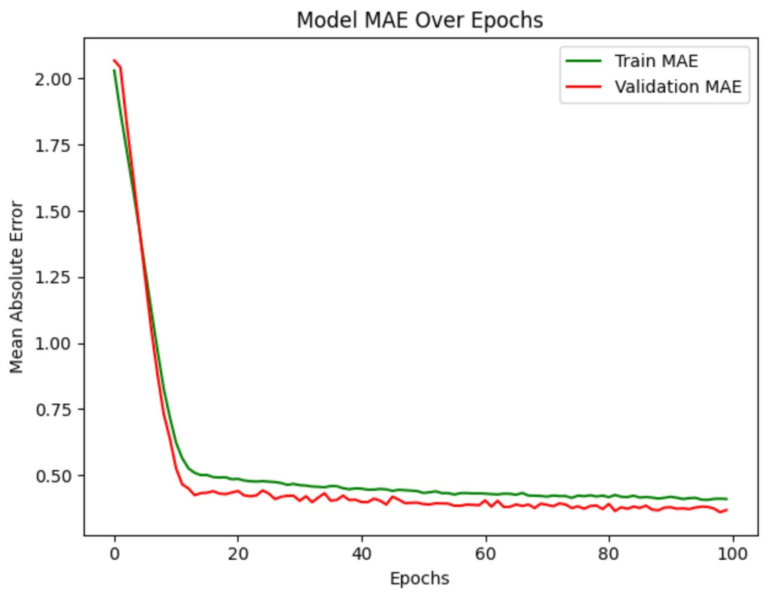

Slide 8
Project Summary and Outcomes
Successfully built a Deep Learning Model that predicts house prices with low loss
Added custom features that improved model learning
Deep neural network performed better than simple linear regression

Slide 9
Future Improvements and Extensions
Try ensemble methods (e.g., DNN + XGBoost)
Use log-scaling of target variable to improve regression stability
Incorporate geolocation-based clustering (e.g., KMeans) as input features
Convert the trained model into a web page using Flask

Slide 10
Reflections and Learning Outcomes
Learned how to apply Deep Learning to real world regression problems
Learned effective feature engineering using domain knowledge
Explored overfitting control using dropout, batch normalization, and early stopping
Gained experience in combining traditional ML techniques with deep learning

Slide 11
THANK YOU

